Slide 1
Photography Basics
Exposure
What is exposure
Relationship between Aperture and Shutter Speed
Effect of change to either Aperture or Shutter Speed
Metering for correct exposure
How ISO fits into exposure
Histograms
Focusing/Depth of Field

Slide 2
Photography Basics
Exposure is simply the amount of light hitting the sensor.
Affected by both aperture and shutter speed
Aperture
Ratio of maximum diaphragm opening to lens focal length
Designated by “f-stops”
Full stops: f/1.4, f/2, f/2.8, f/4, f/5.6, f/8, f/11, f/16, f/22
Each stop going up represents a reduction by 50% of light allowed in; conversely each stop going down doubles the light allowed in.
Many cameras allow for increments of 1/3 or ½ stop

Slide 3
Photography Basics
Shutter Speed is the duration of time a shutter is “open,” allowing light from the lens to reach the sensor.
Shutter Speed is designated in seconds or fractions thereof.
Typically from 30 seconds, halving at each stop to maximum shutter speed (1/8000 sec in many modern DSLR and mirrorless cameras)
Each increase in shutter speed setting cuts the amount of light reaching the sensor in half.

Slide 4
Photography Basics
Relationship between Shutter Speed and Aperture
An increase of one stop of shutter speed requires a decrease in one stop aperture (lower number but wider opening).
Exposure of 1/250s at f/2.8 is the same exposure as 1/125s at f/4 (1 stop change). 1/1000 s at f/5.6 is the same as 1/60s at f/16 (4 stop change).

Slide 5
Photography Basics
Relationship between Shutter Speed and Aperture – Artistic Considerations
Wide aperture = shallow depth of field
Narrow aperture = increased depth of field
Slow shutter speed = give the illusion of movement
Fast shutter speed = freeze action

Slide 6
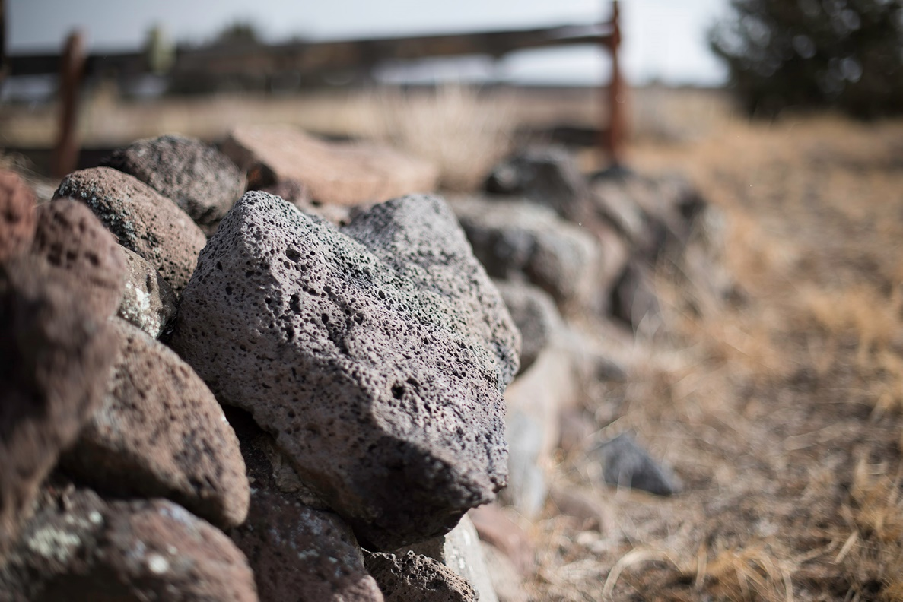
Photography Basics

Slide 7
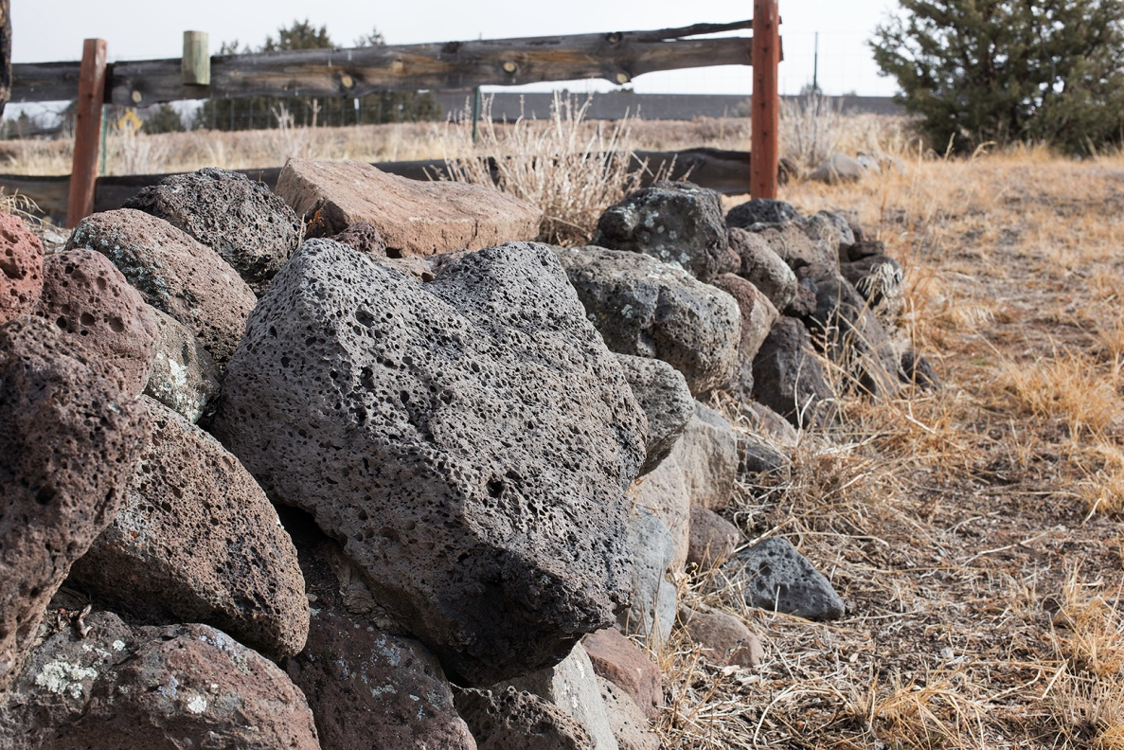
Photography Basics

Slide 8
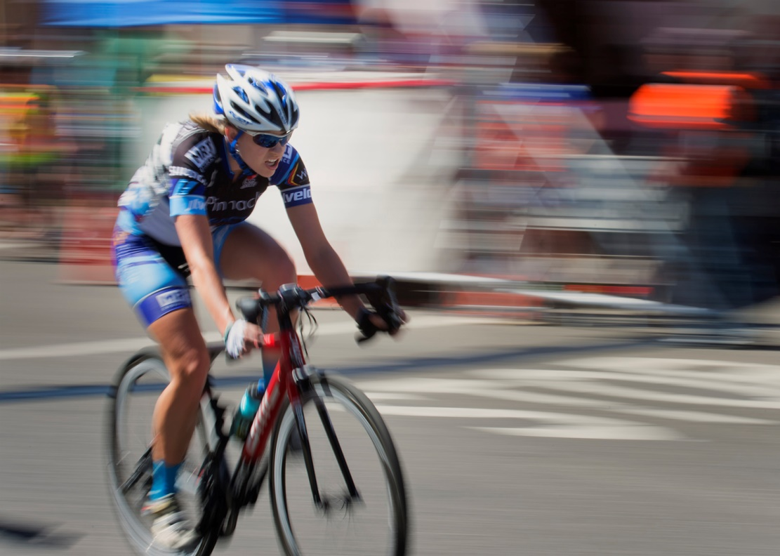
Photography Basics

Slide 9
Photography Basics

Slide 10
Photography Basics
Metering
Basically three types
Matrix – Uses entire frame to average
Center Weighted – Uses entire frame but weights the center (center size is usually customizable)
Spot – Uses a circle (“spot”) comprising 1-2% of frame centered on focus point

Slide 11
Photography Basics
Additional Considerations:
When situation calls for a particular aperture and shutter speed, resulting in over/under exposure
Over exposure - Neutral Density Filters
Under exposure –
Increase ISO
External lighting

Slide 12
Photography Basics
Additional Considerations: ISO
With film, ISO was used to designate sensitivity to light
In digital cameras, a sensor can capture only a maximum amount of light, period.
ISO increase doesn’t change that
ISO increase is an electronic “brightening” of whatever light is captured by the sensor
A doubling of ISO = 1 stop increase

Slide 13
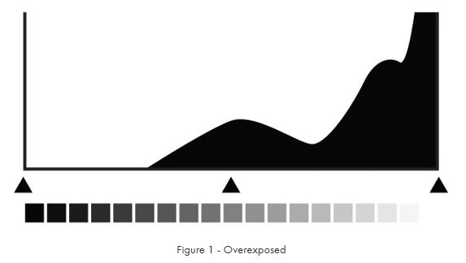
Photography Basics
Histogram

Slide 14
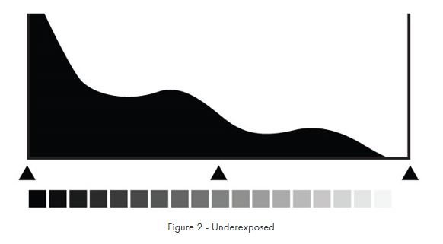
Photography Basics
Histogram

Slide 15
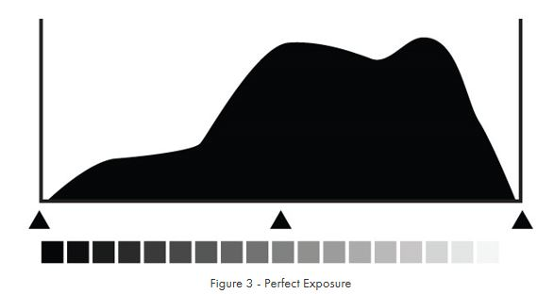
Photography Basics
Histogram

Slide 16
Photography Basics
Additional Considerations: Focusing Distance
Hyperfocal Distance (HFD)
Minimum focusing distance beyond which scene is acceptably sharp to infinity
HFD is dependent on aperture and focal length

Slide 17
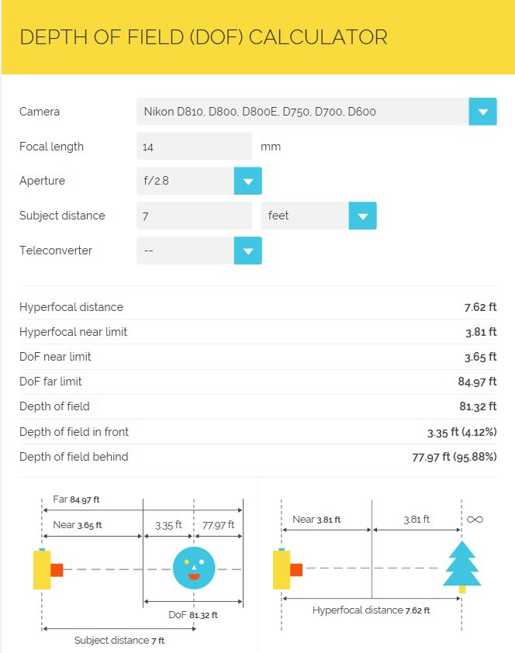
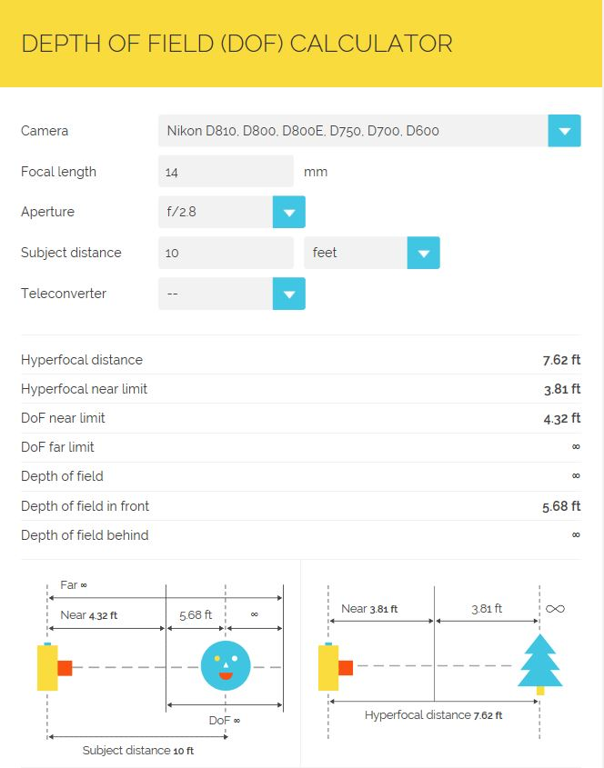

Slide 18
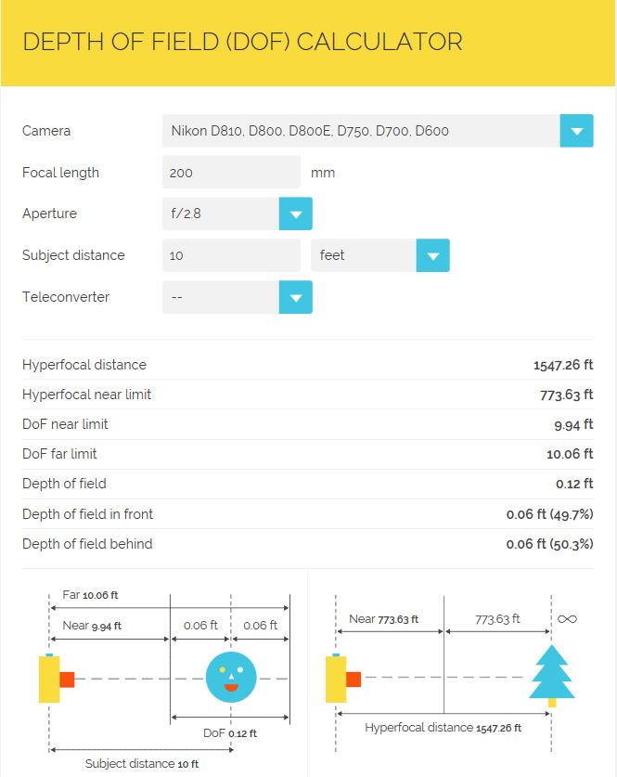
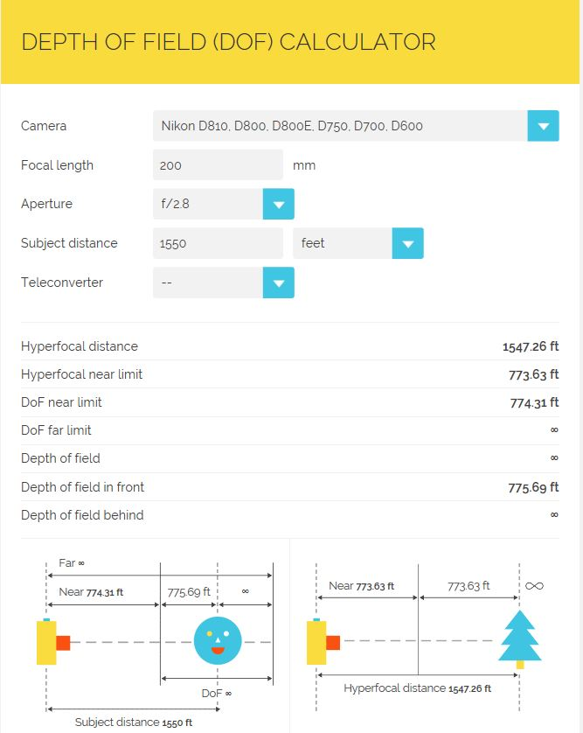

Slide 19
