Slide 1
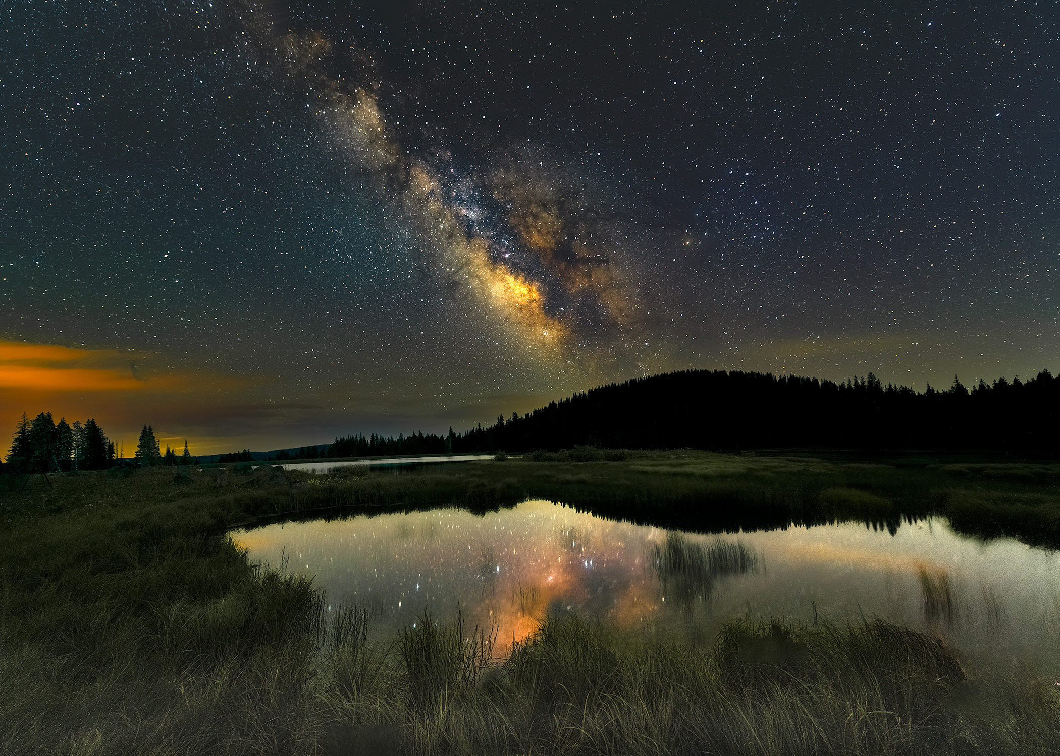
Milky Way Photography and Blending Blue Hour Foreground

Slide 2
Basics
Equipment
  Camera that can be set to manual
  Sturdy tripod
  Remote shutter release
    Or at least ability to delay shutter release
  Fast lens
    Faster the lens, the lower the ISO

Slide 3
Planning
Objectives
  Milky Way
  Blue Hour

Slide 4
Planning
Tools
  PhotoPills
    We will be doing a session on using in the next couple of months
  Stellarium
  TPE
  Weather Apps

Slide 5
How – Blue Hour
Composition
  Use the same focal length as will be used for MW
    Different focal lengths can be used but blending is a bit more involved (beyond scope of this presentation)
  Compose the image
    Visualize how you want final image to look
      Is the MW the subject or is the foreground
      Compose accordingly

Slide 6
How – Blue Hour
Focus
  Once composition is set, do not disturb
  Therefore, focus on a very distant object (essentially at infinity) and set to manual focus before composing
  With a wide angle lens, the distant foreground will be sharp
    If focus stacking close foreground objects, start close and focus to infinity (on a distant object)
      Process stacked images as normal before blending with MW

Slide 7
How – Blue Hour
Aperture
  Suggest using the same aperture which will be used to shoot MW
  Smaller aperture can be used for foreground but sometimes “focus shift” can occur which may require refocusing
    Not a concern if you are confident your camera/lens combo is not prone to this
    If you need to refocus, be careful to not alter composition

Slide 8
How – Blue Hour
Exposure
  Expose for the foreground
    Sky exposure is irrelevant as it will be replaced with MW
  Expose to slightly underexpose foreground
    Bright enough to capture detail but dark enough to not create an unnatural contrast with the MW

Slide 9
How – Milky Way
Exposure
  Use wide open aperture
  Use as high an ISO as reasonable for your camera
  Shutter duration depends on aperture, focal length and megapixels of camera
    To reduce unwanted star trails use 500 rule (or 400 or 300)
      500/Focal length = shutter duration
        Crop sensors must be accounted for
        E.g. 14mm using at 1.5 crop sensor = effective focal length of 19mm
      Doesn’t take into account pixel density of sensor

Slide 10
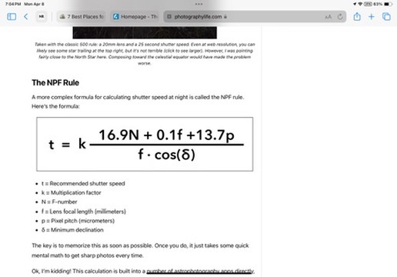
How – Milky Way
Exposure
Notes:
Might be a bit complicated to use, so just use the tool provided in PhotoPills (next slide)

Slide 11
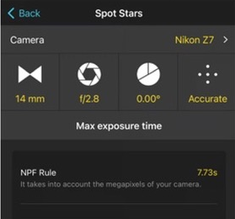
How – Milky Way
Exposure

Slide 12
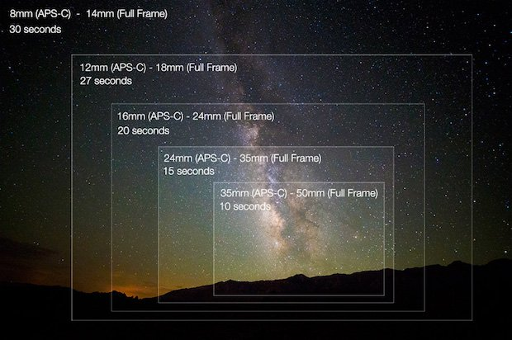

Slide 13
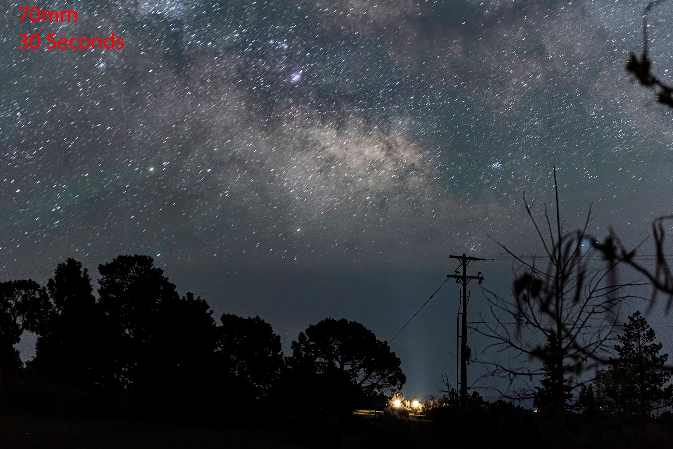

Slide 14
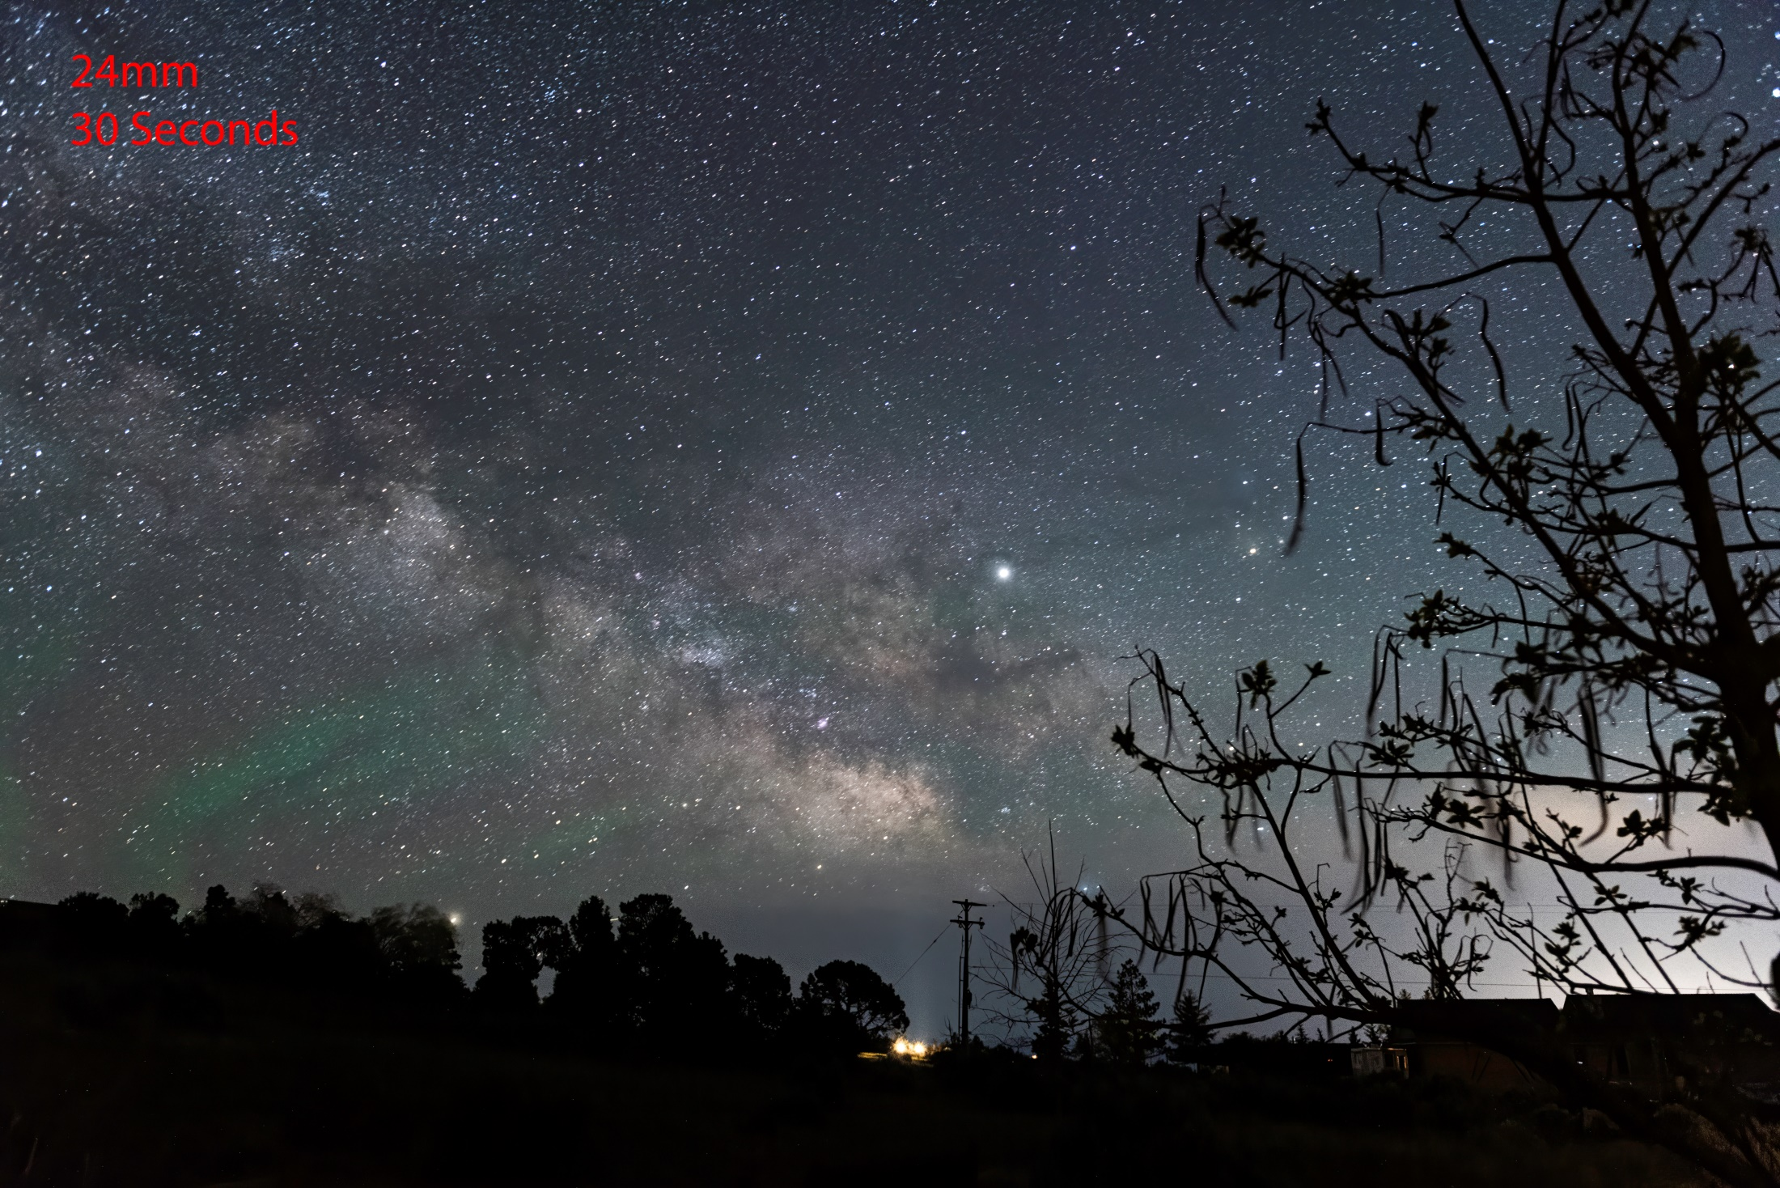

Slide 15
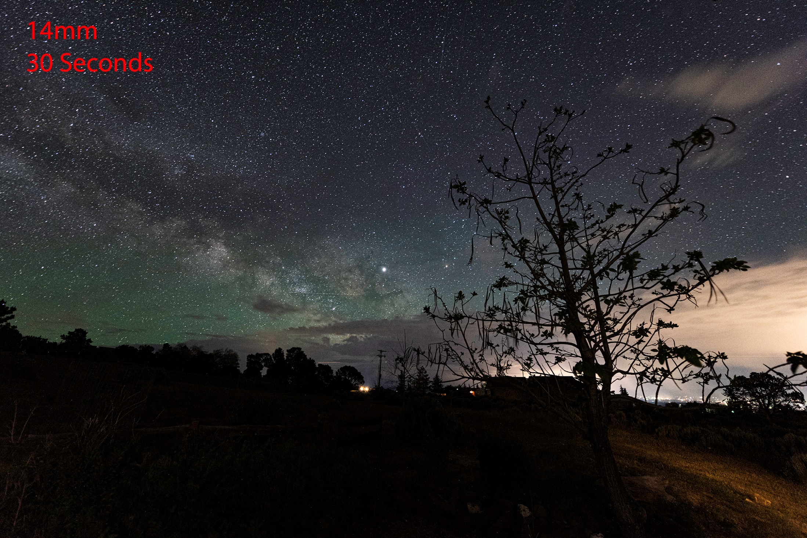

Slide 16
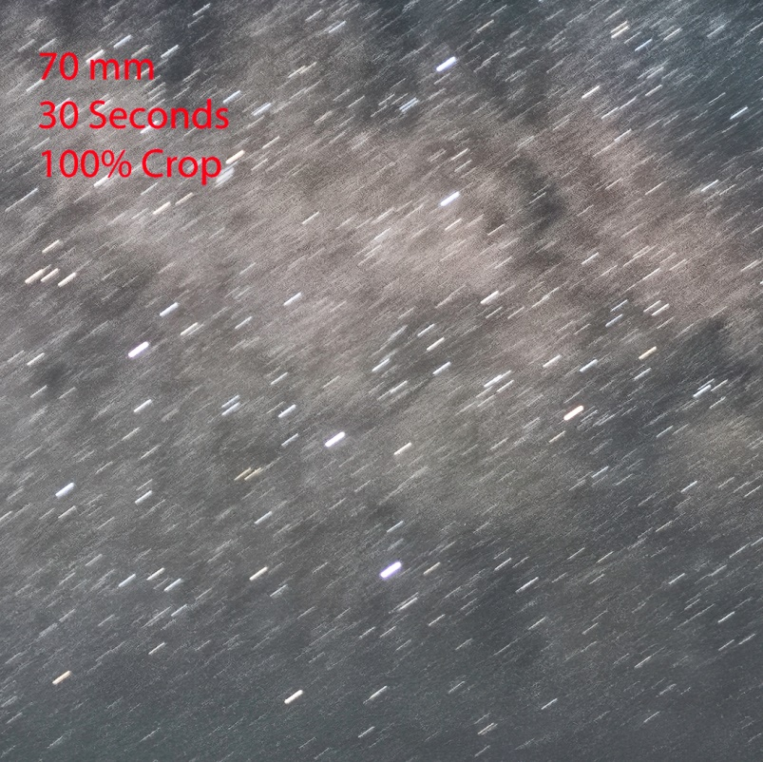

Slide 17
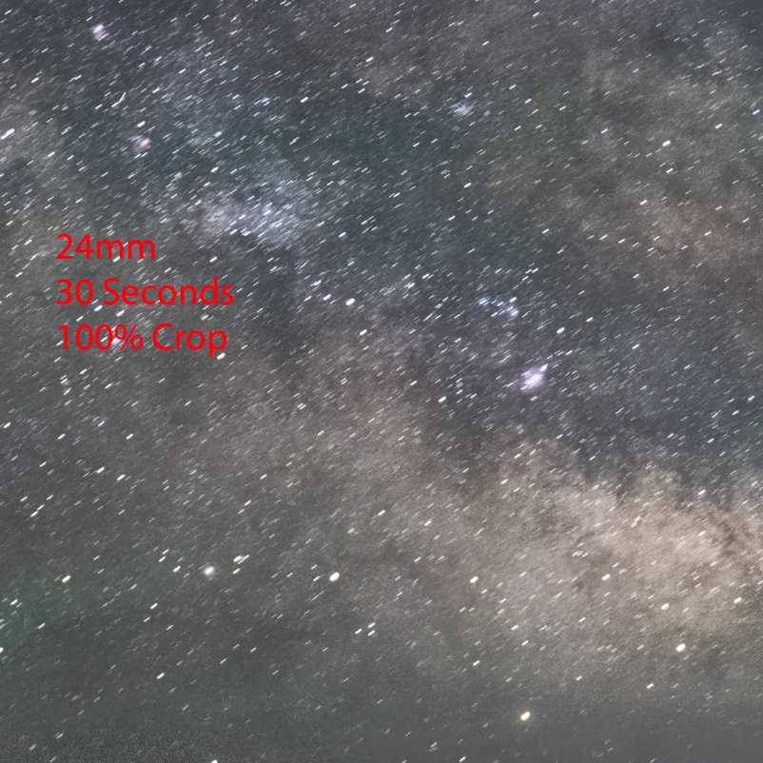

Slide 18
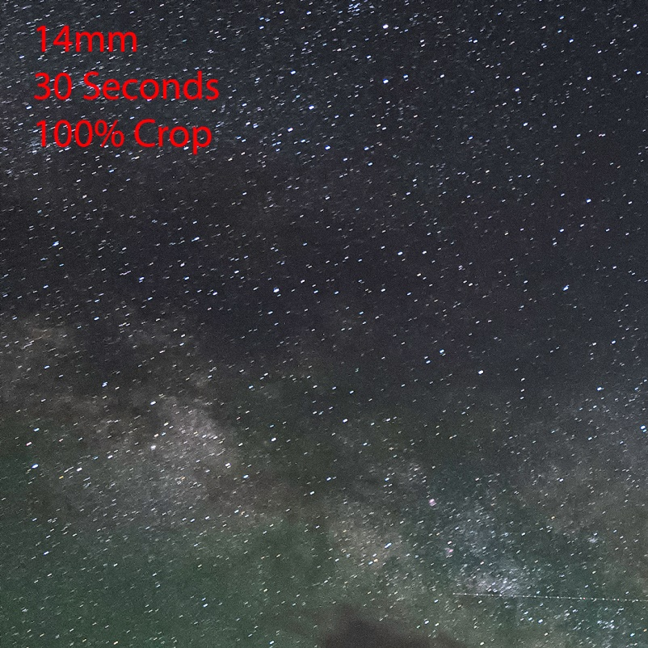

Slide 19
How – Milky Way
Shoot in RAW
Focusing
  Use “Live View” if available
    Find bright star and magnify in
    Use manual focusing
      If you don’t use back button focusing, make sure to switch to manual focusing to prevent refocusing when shutter is depressed
      Can use a loupe to help with manual focusing
  If “Live View” not available
    Focus on something at infinity during the day and mark (or tape) the location on the lens

Slide 20
How – Milky Way
To help reduce noise, consider taking a series of 10 – 20 images (or more) in rapid succession
  Process using 3rd party software (discussed in a moment)
Note: When photographing with others be aware of headlamps and other external light sources
  It doesn’t take much to flood a long exposure

Slide 21
Processing- Milky Way
Play around with white balance, contrast, color grading
To help reduce noise, stack photos
  Sequator for PC (free!)
  Star Stacker for Mac (not free!!)
Stacked Photos
  Noise is random
  Software compares 6-10 photos and aligns them
    Pixels that appear random are removed
  Leaves more detail in photos than traditional noise reduction software or utilities

Slide 22
Blending Blue Hour and MW Images in Photoshop
There are a number of ways to blend images in PS
The two easiest and straightforward methods will be discussed here:
  Using the ”Sky Replacement” feature
  Masking out the sky and blending two layers

Slide 23
Blending Blue Hour and MW Images in Photoshop
Using “Sky Replacement Feature”
  Open “blue hour” image in Photoshop
  Follow directions on next few slides

Slide 24
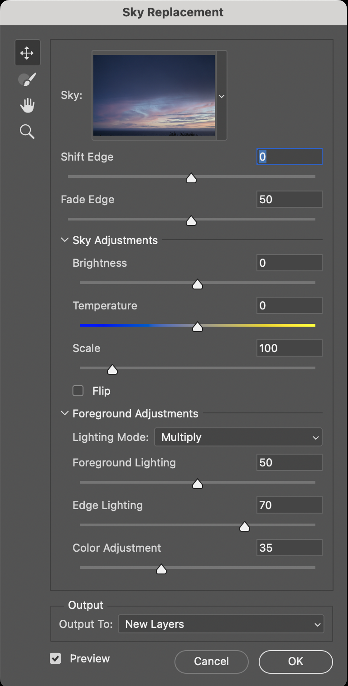
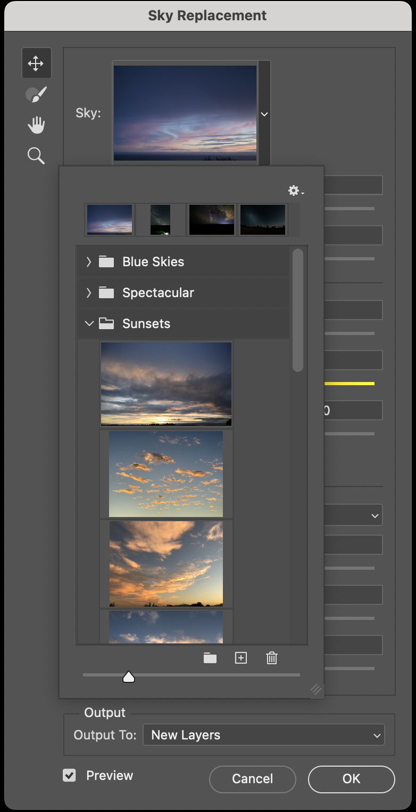
Click on drop down
Click on “+” sign
Navigate to folder containing MW image
Choose image and import

Slide 25
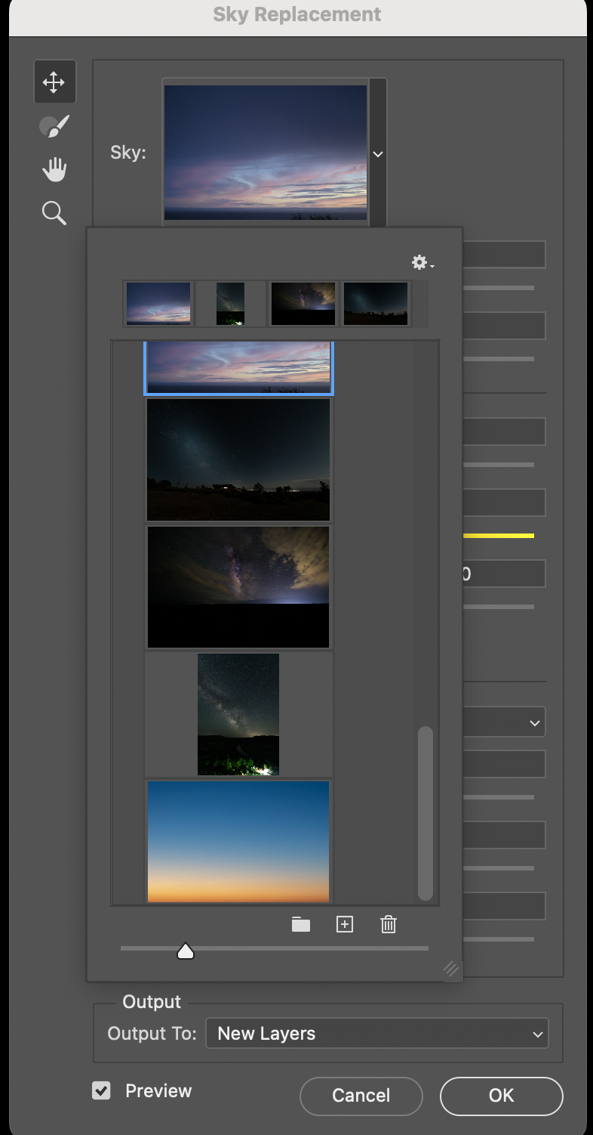
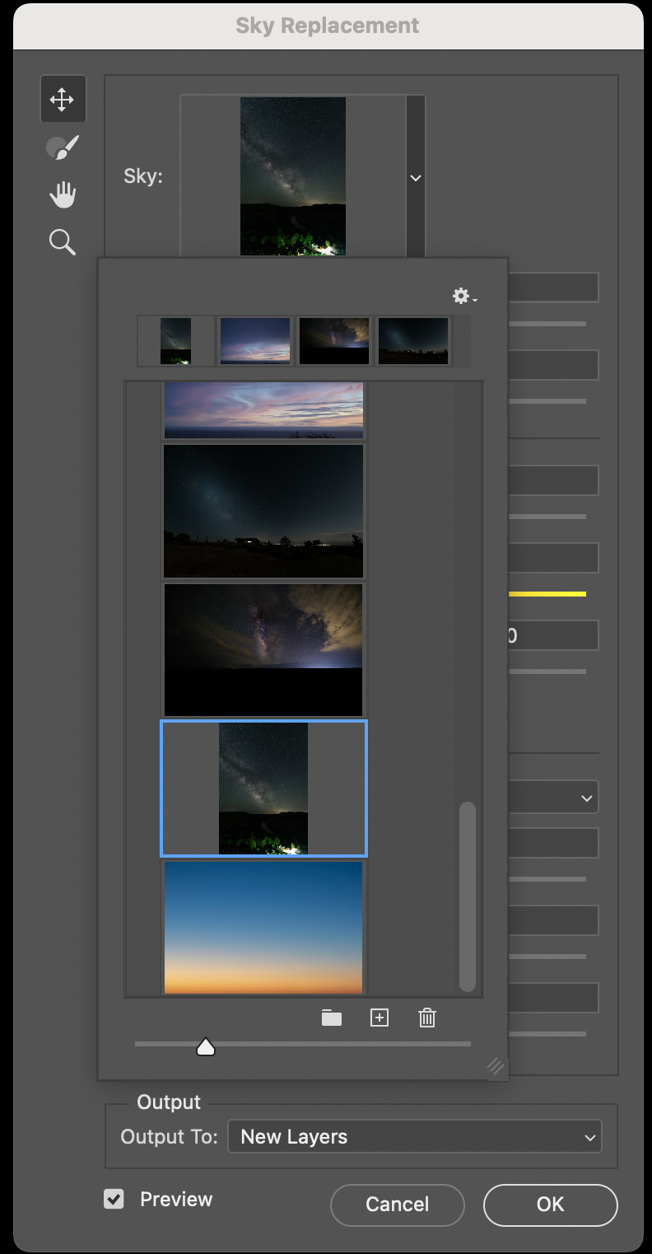
Click on drop down
Scroll down to find MW image
Click on image
Chosen image will appear in top window

Slide 26
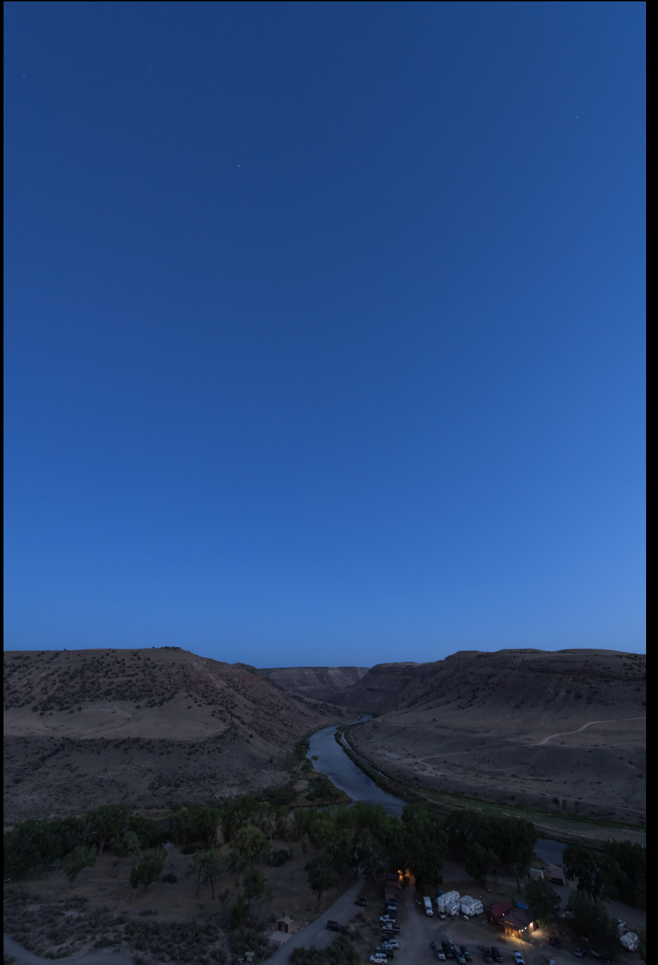
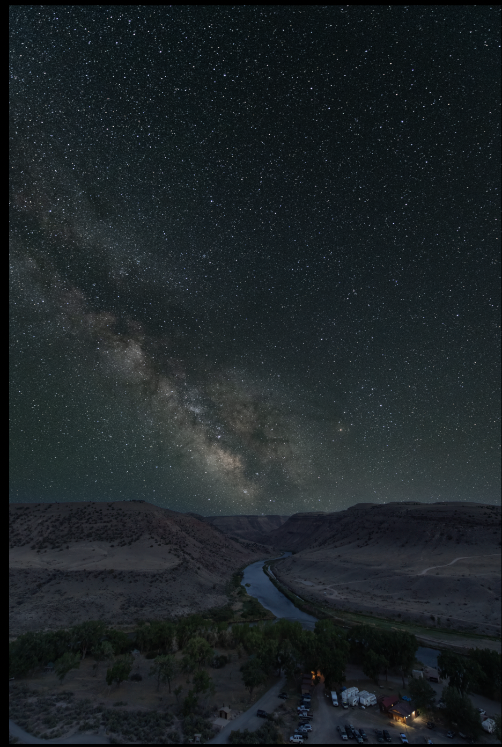

Slide 27
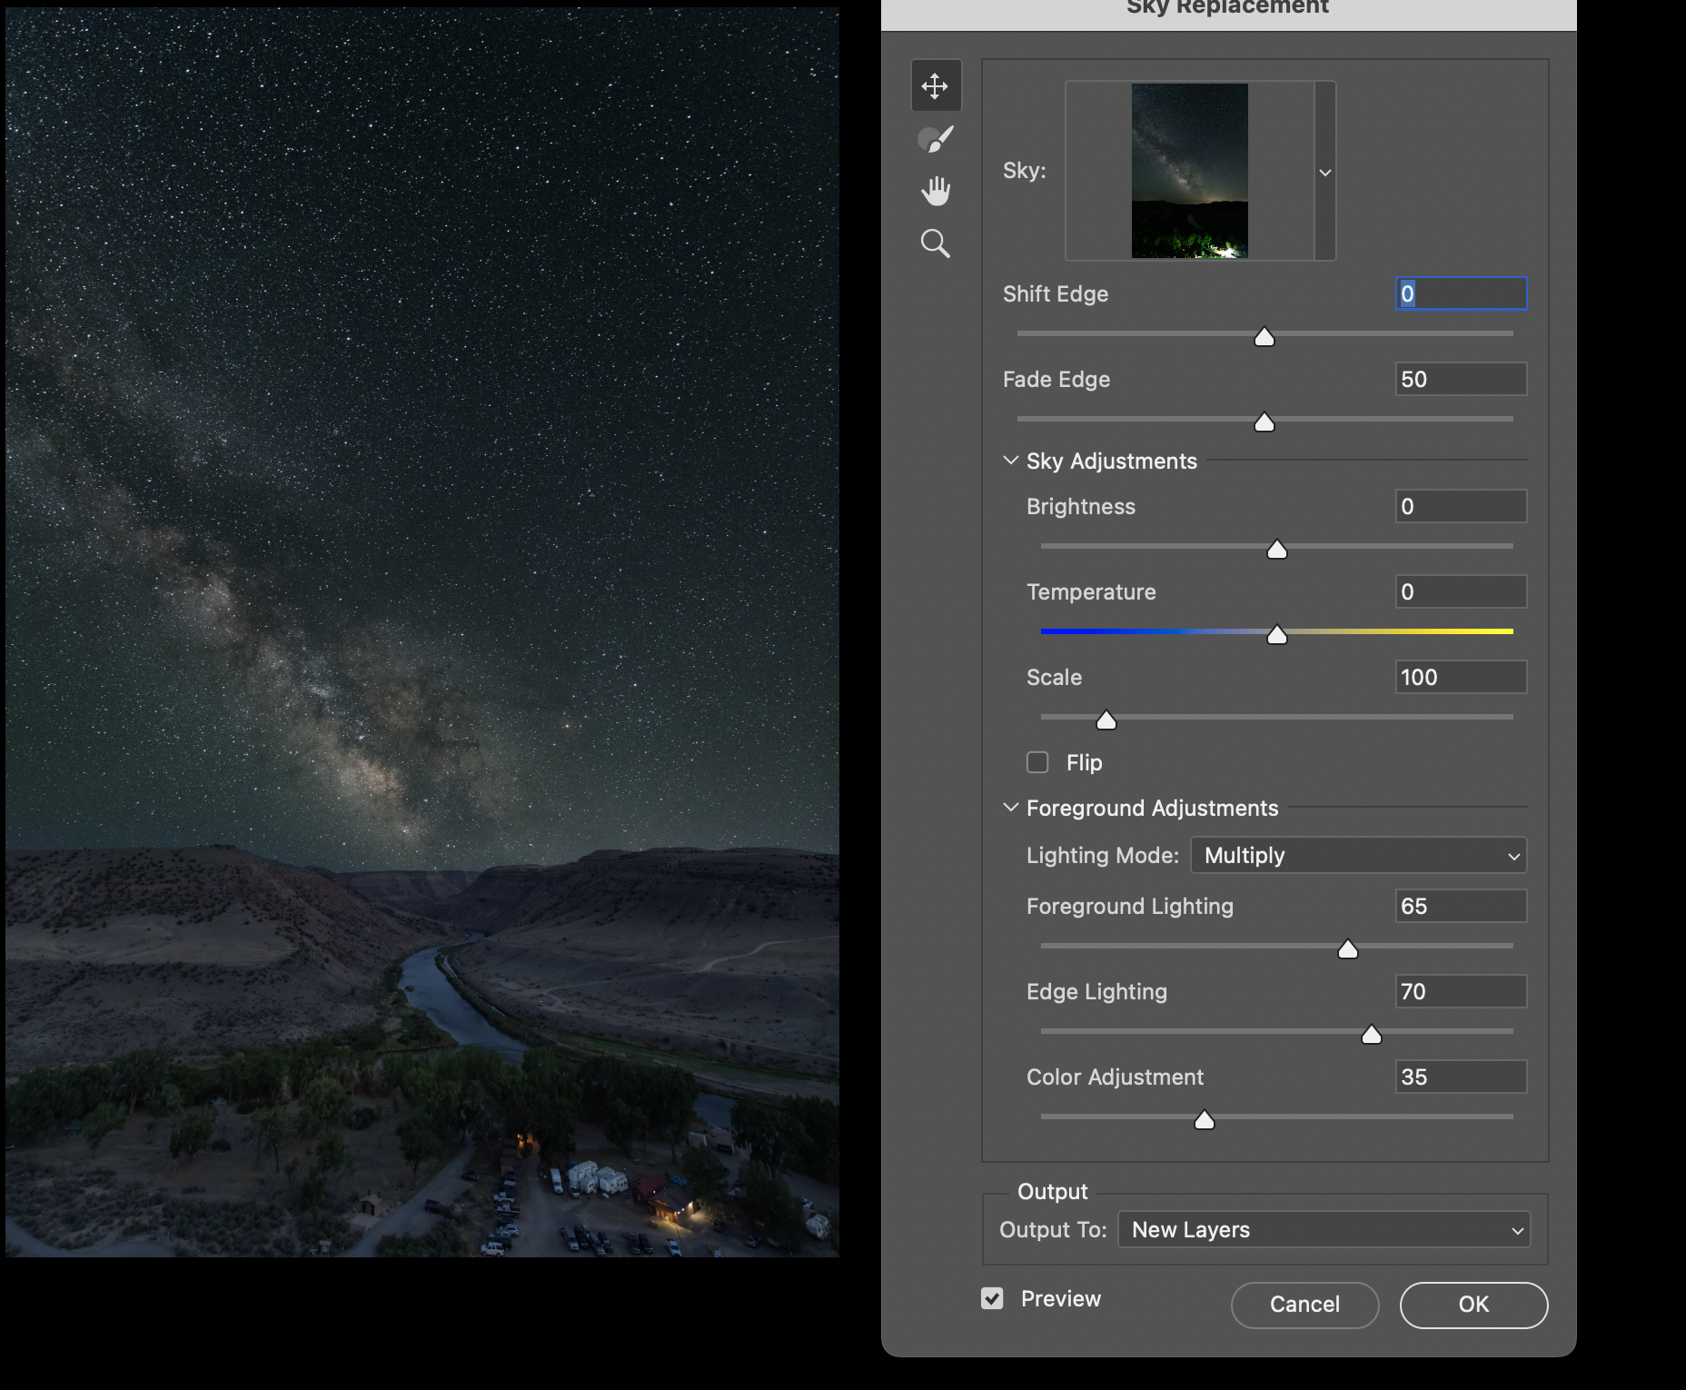
Once the MW is in place, right click anywhere on the ”Sky Replacement” drop down to close the ”Choose Sky” dropdown
Play with the available sliders to see what they do and adjust the image to taste (”Shift Edge,” “Fade Edge,” and “Edge Lighting” are often necessary adjustments)

Slide 28
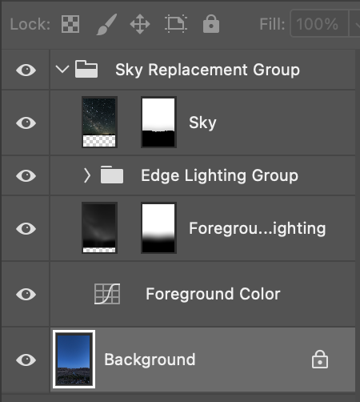
After selecting your sky, the layer panel will look like this.
You can then flatten the layers (or create a stamp layer) and continue editing in Photoshop or save back to Lightroom to finish editing.

Slide 29
Blending Blue Hour and MW Images in Photoshop
Using Layer Masking Technique
Open both foreground and MW images in PS
  Option 1
    From Lightroom, select both images and “open as layers in Photoshop”
  Option 2
    In Photoshop, open each image separately
  Follow directions on next few slides

Slide 30
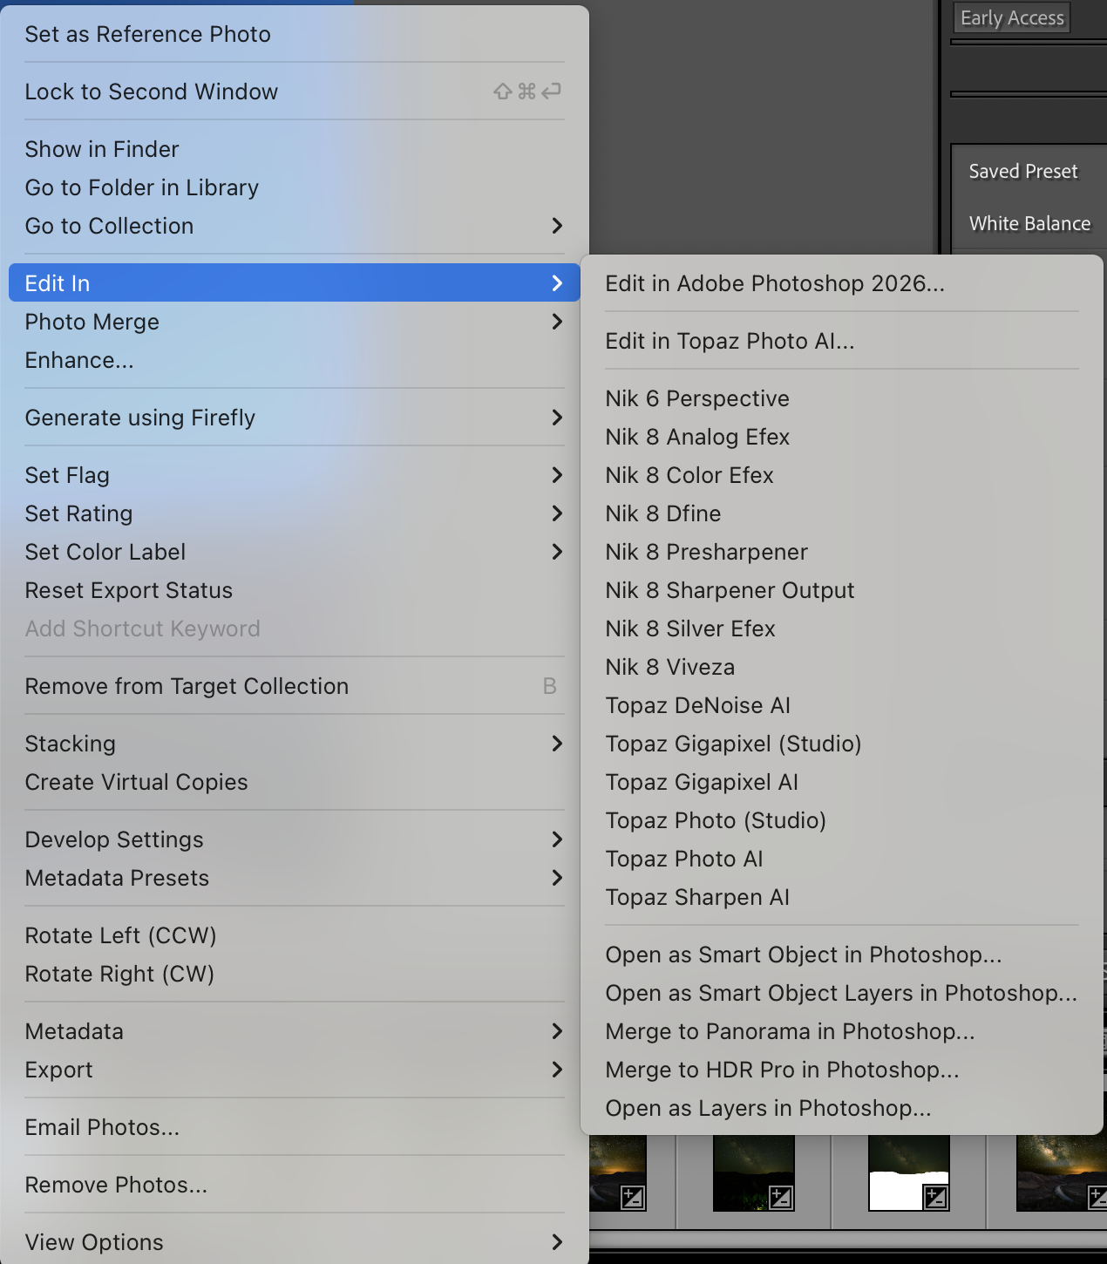
Blending Blue Hour and MW Images in Photoshop
Option 1

Slide 31
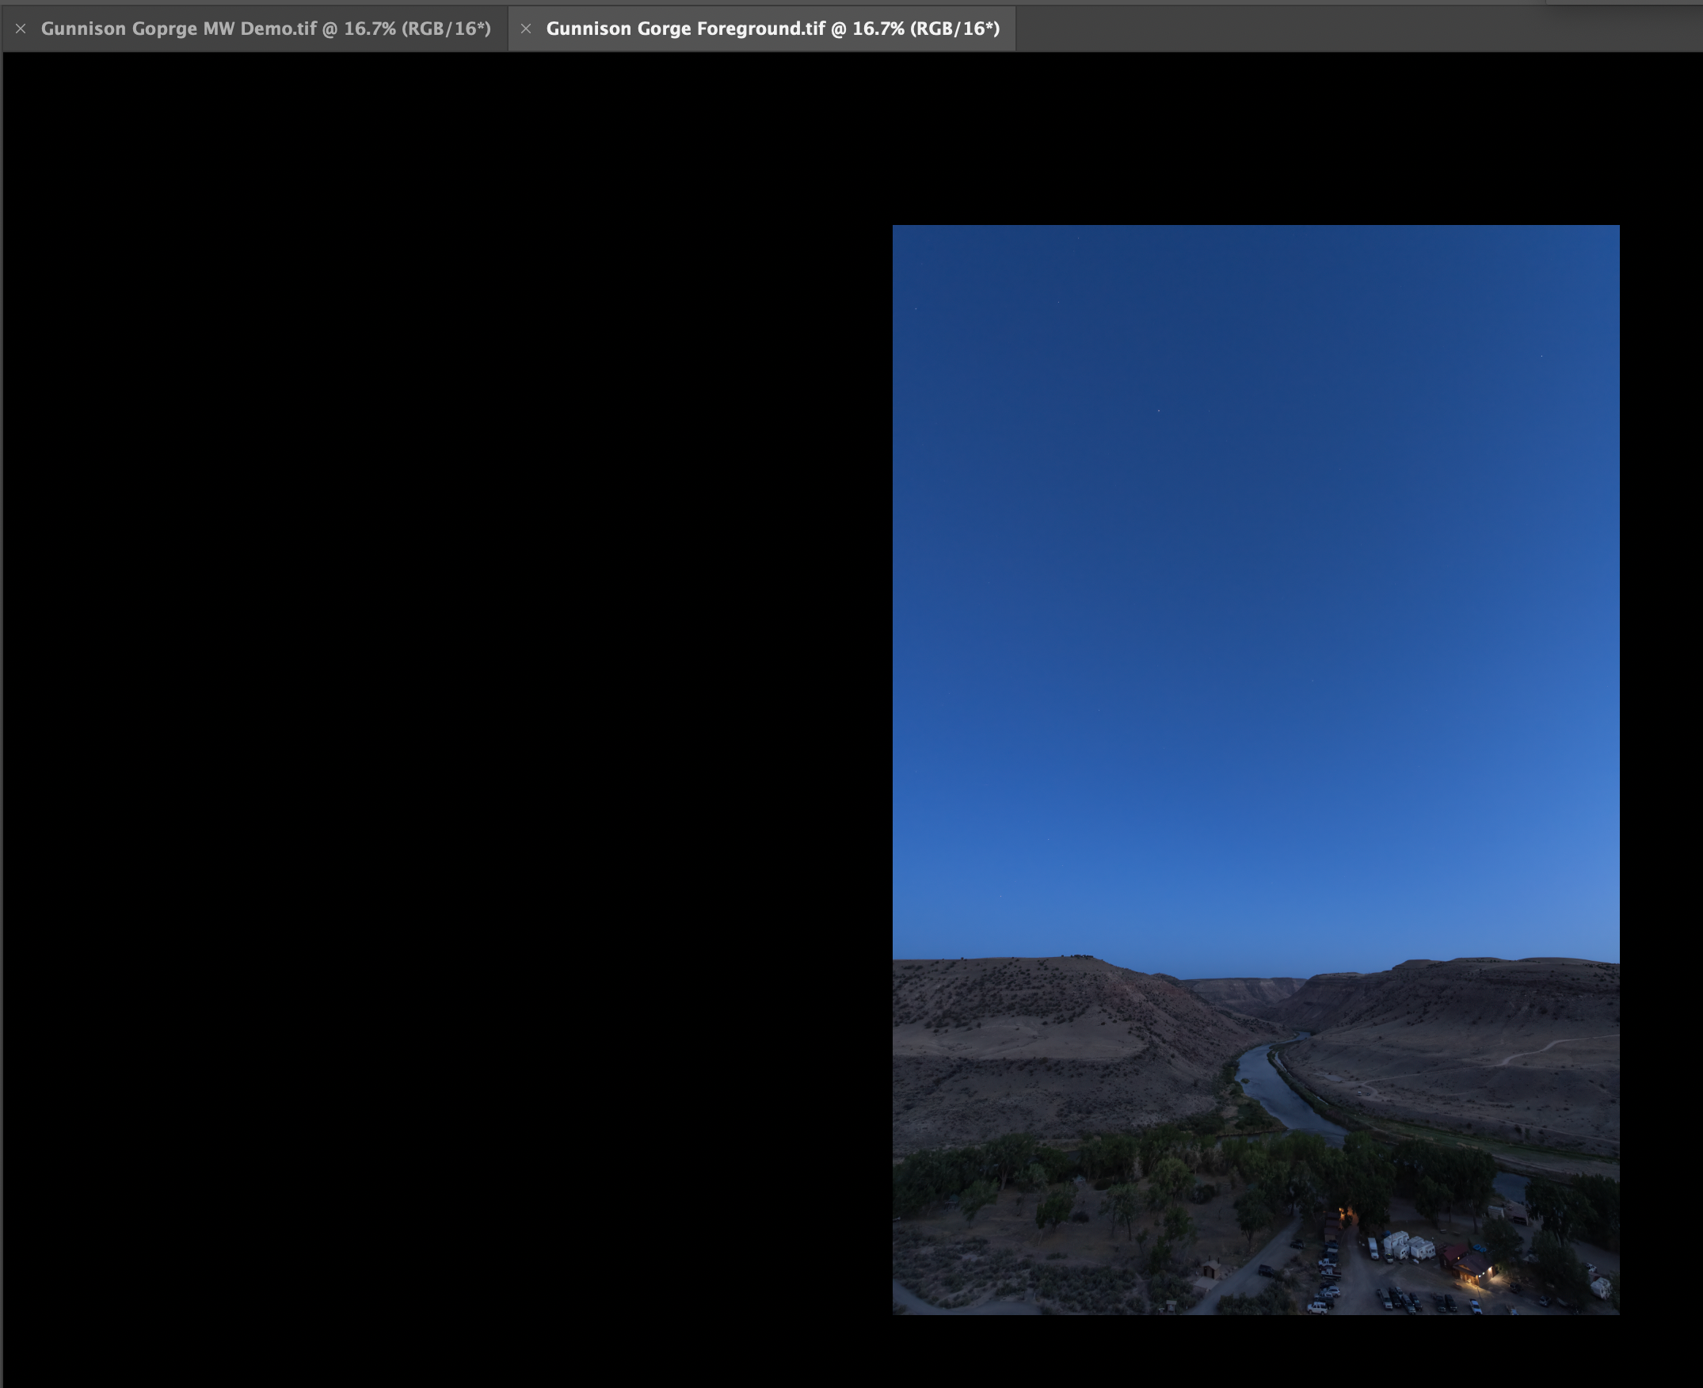
Blending Blue Hour and MW Images in Photoshop
Option 2
Open images individually in Photoshop

Slide 32
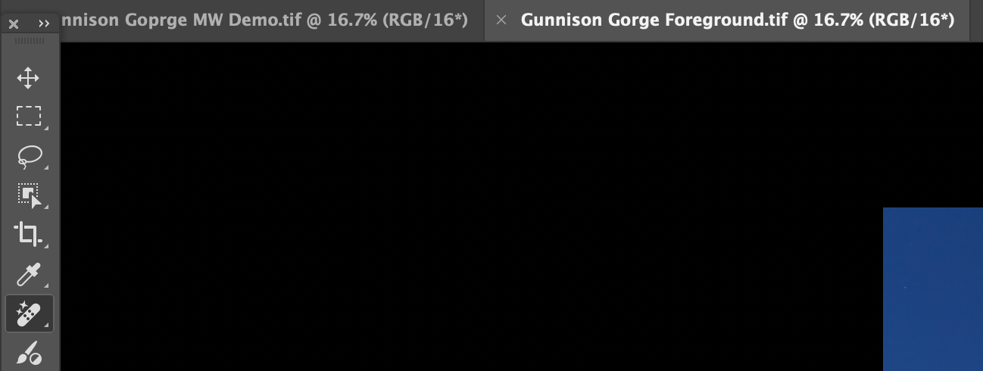
Blending Blue Hour and MW Images in Photoshop
Method 2
Select the “Move Tool”

Slide 33
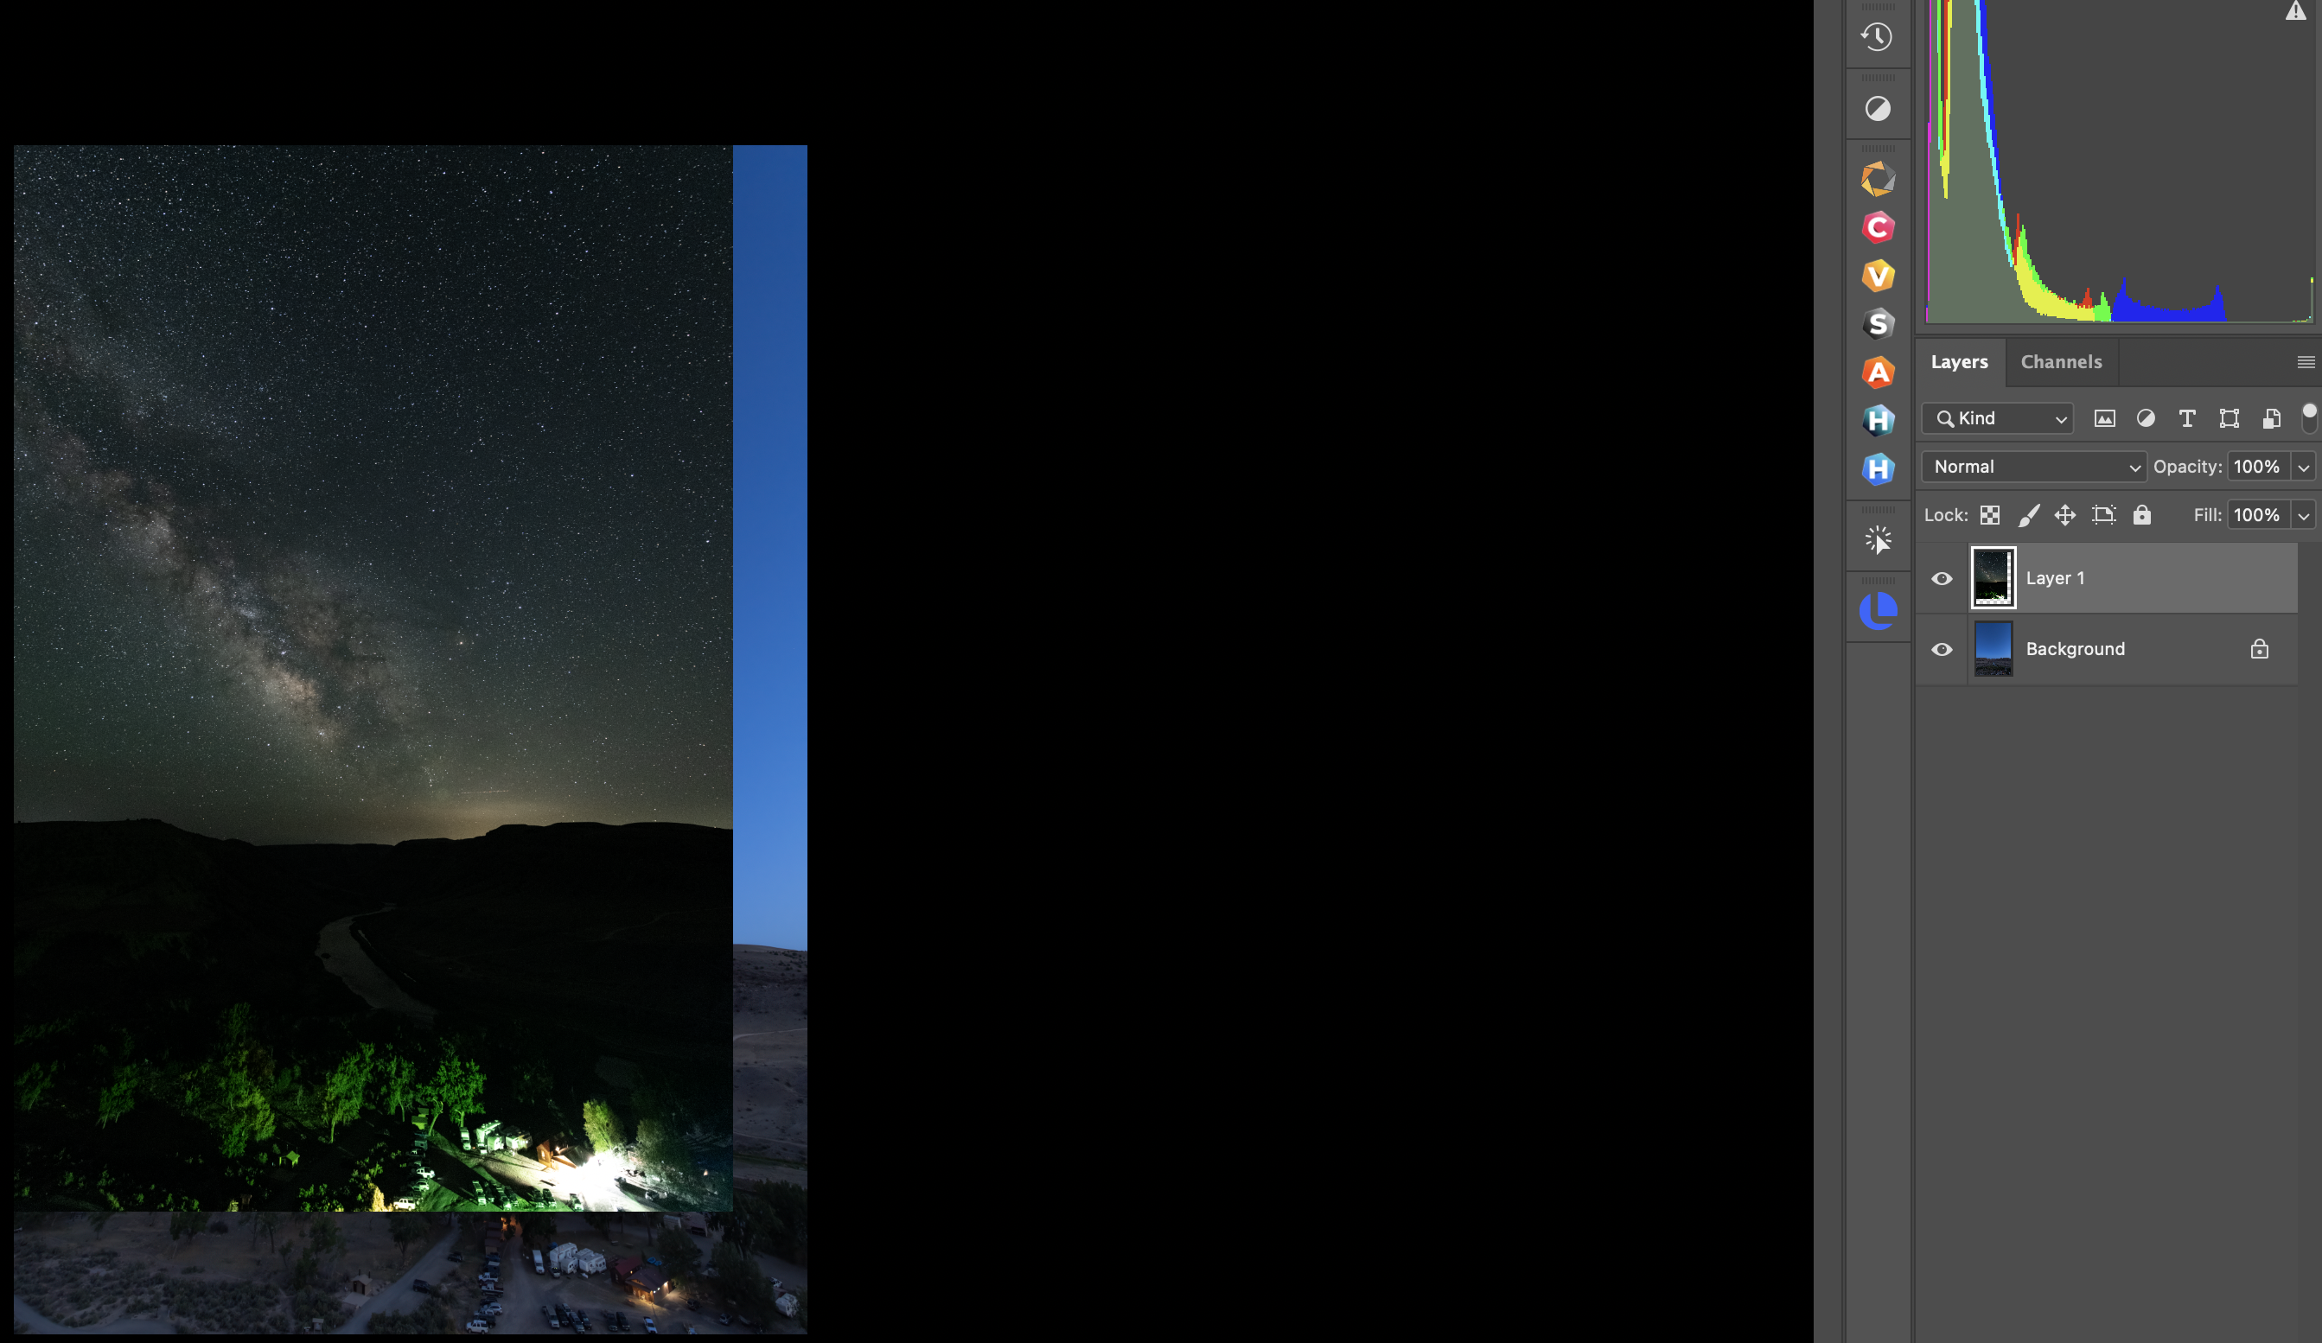
Blending Blue Hour and MW Images in Photoshop
Method 2
Select the “Move Tool”
Place the move tool over whichever image is visible
Left click and move the move tool from the image to the tab of the other image and then back to the visible image and release
The two images will now be shown as two layers
If necessary, use the move tool to align the two images

Slide 34
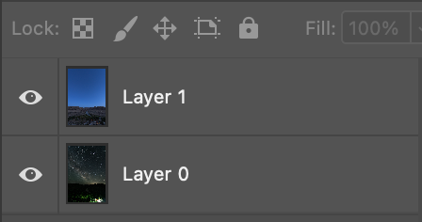
Blending Blue Hour and MW Images in Photoshop
If the foreground image is not the top layer, click the lock icon on the background layer and drag it on top of the MW image so they are arranged as indicated

Slide 35
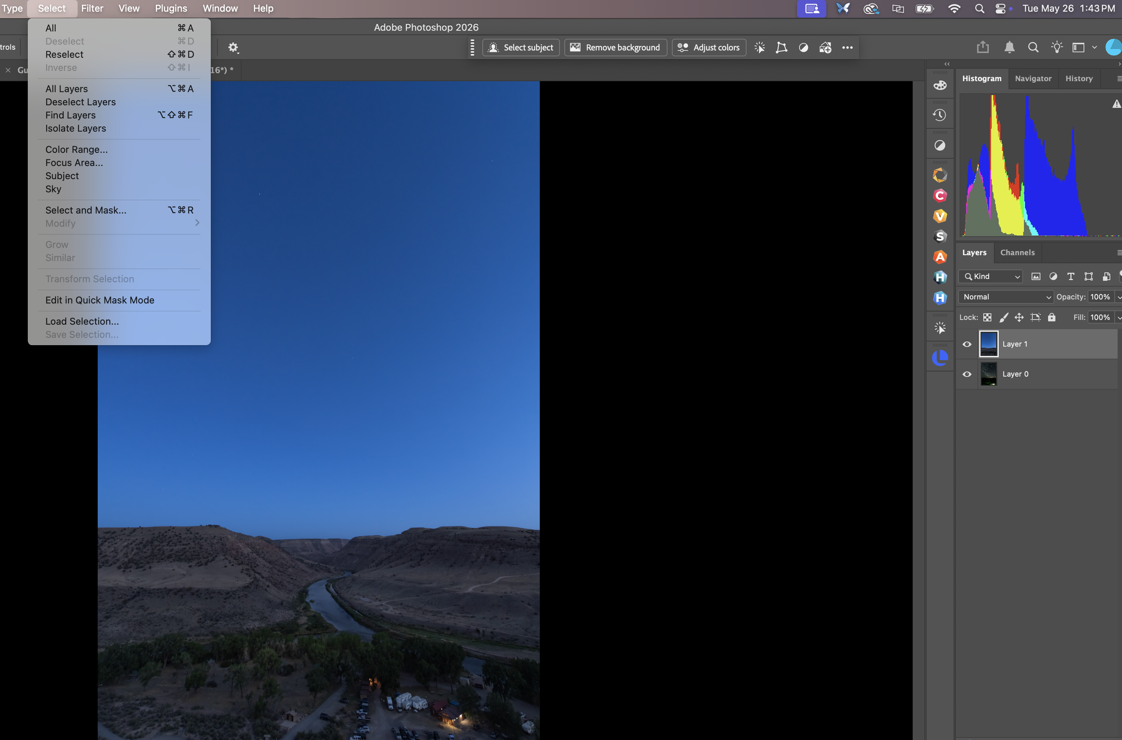
Blending Blue Hour and MW Images in Photoshop
With the foreground layer selected, from the “Select” menu choose “Sky”

Slide 36
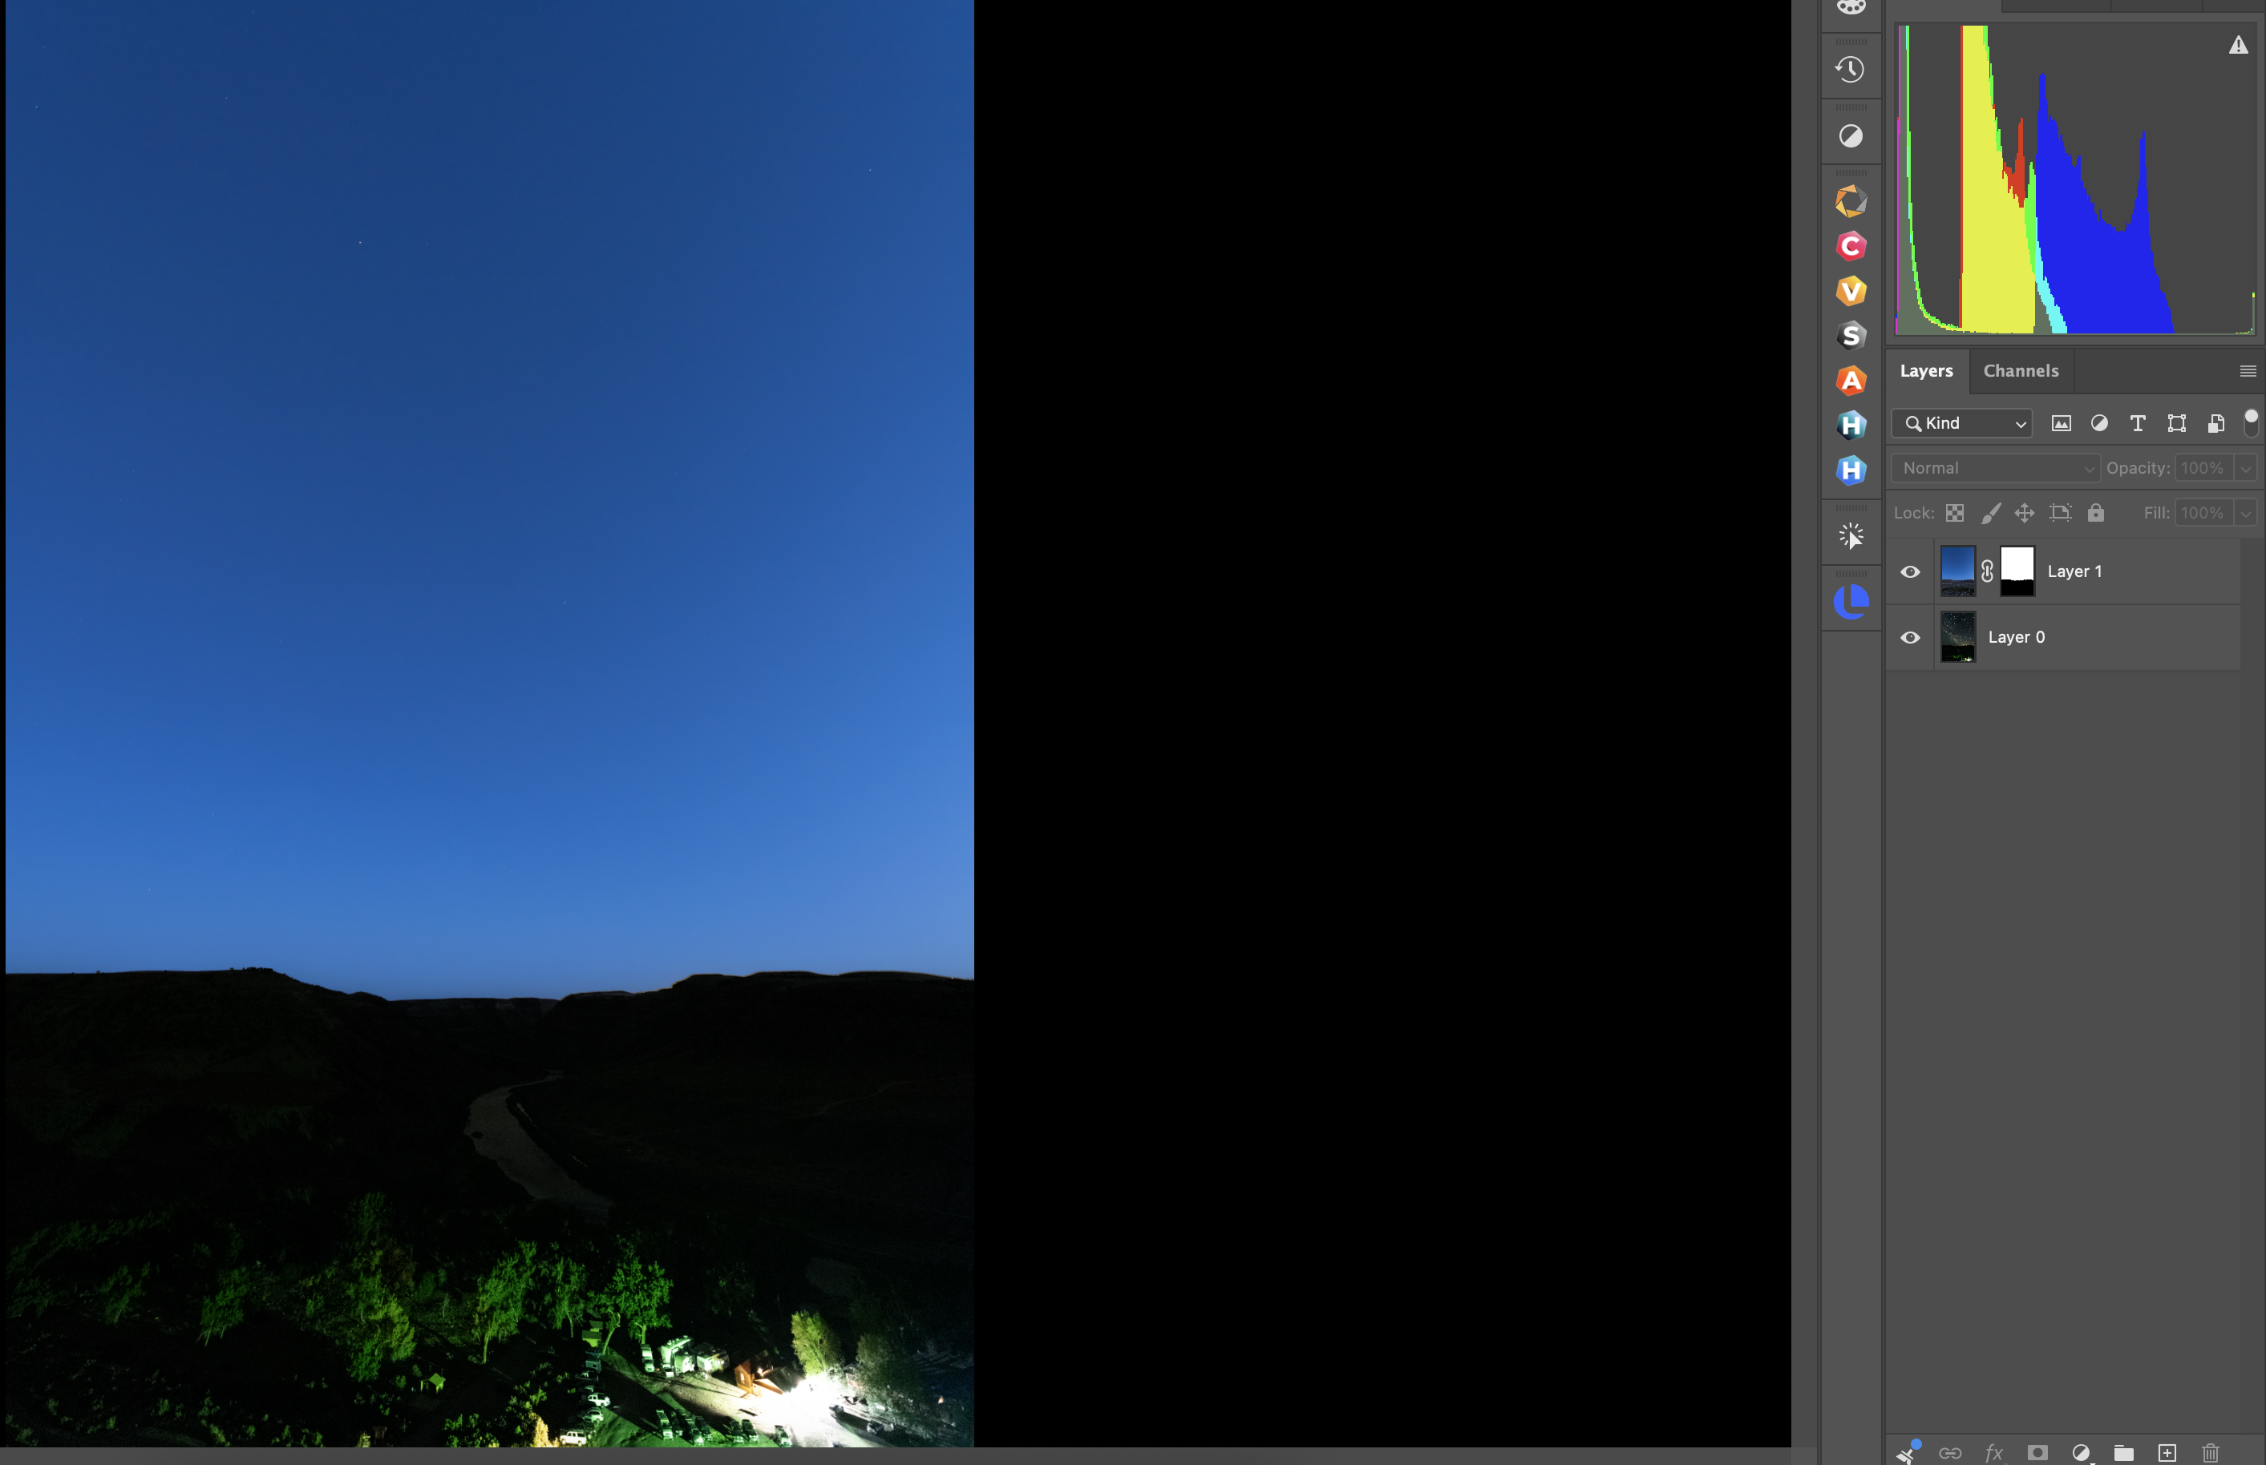
Blending Blue Hour and MW Images in Photoshop
With the selection layer active, click the mask icon
The layers panel will look as indicated
Note that the MW is not yet visible and that the foreground has been masked out.

Slide 37
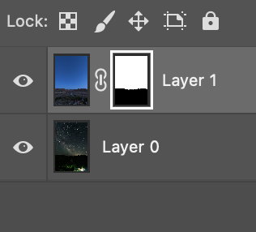
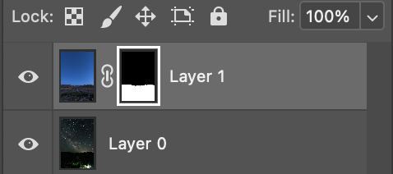
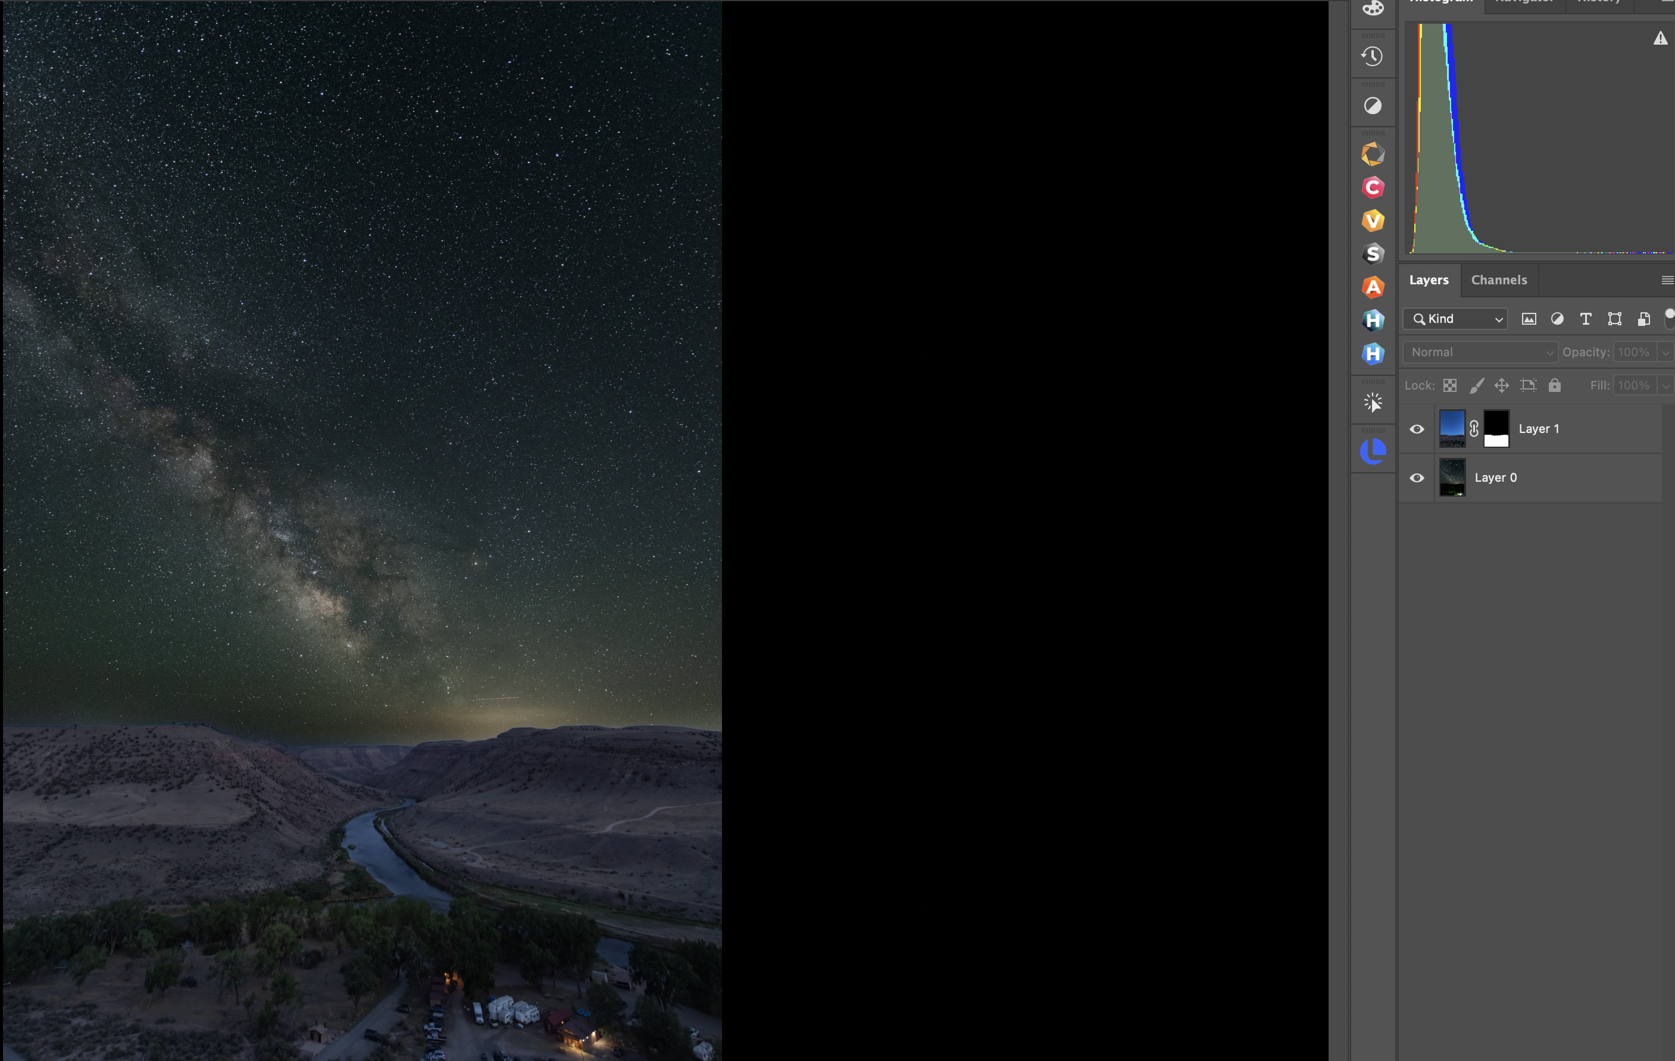
Blending Blue Hour and MW Images in Photoshop
With the mask active (indicated by a white outline), hit Cmd (Mac) or Ctrl (Windows) and the letter “i” to invert the mask
The layer panel will now look as indicated on the right and the MW will now show through on the image

Slide 38
Blending Blue Hour and MW Images in Photoshop
You can now save the image back into Lightroom or continue editing in Photoshop
The second method (masking in Photoshop) often provides the best results depending on the foreground
  Most often the case if the foreground requires more complex selections than can be achieved by simply using “Sky Replacement”

Slide 39
Field Trip
  Sometime in July
  Details to follow

